Slide 1
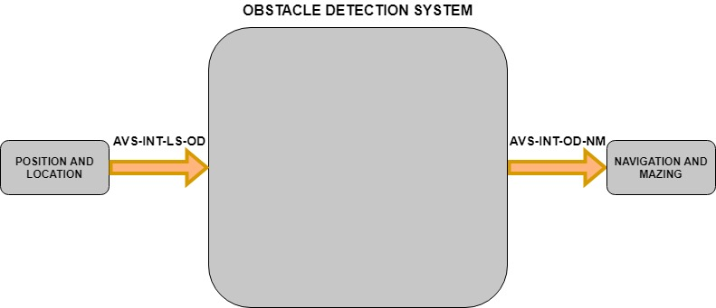
Obstacle Detection System - Black box
Purpose: To detect and locate obstacles
Notes:
I’ll be briefly talking to you about the Obstacle Detection System.
It’s purpose is to detect and locate obstacles and output their location to the navigation system for better route planning.

Slide 2
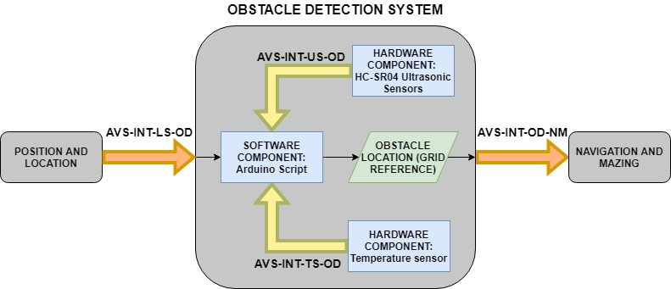
Obstacle Detection System - Internal
*if required*
Notes:
Internally it will require up to three major interfacing components:
The Ultrasonic sensors
Temperature sensor if required
And the Arduino Script that will combine the inputs and convert into a grid reference to be outputted to the navigation system.

Slide 3
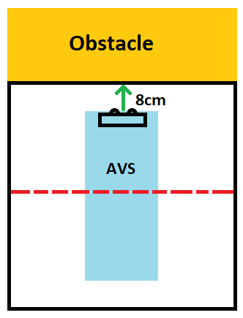
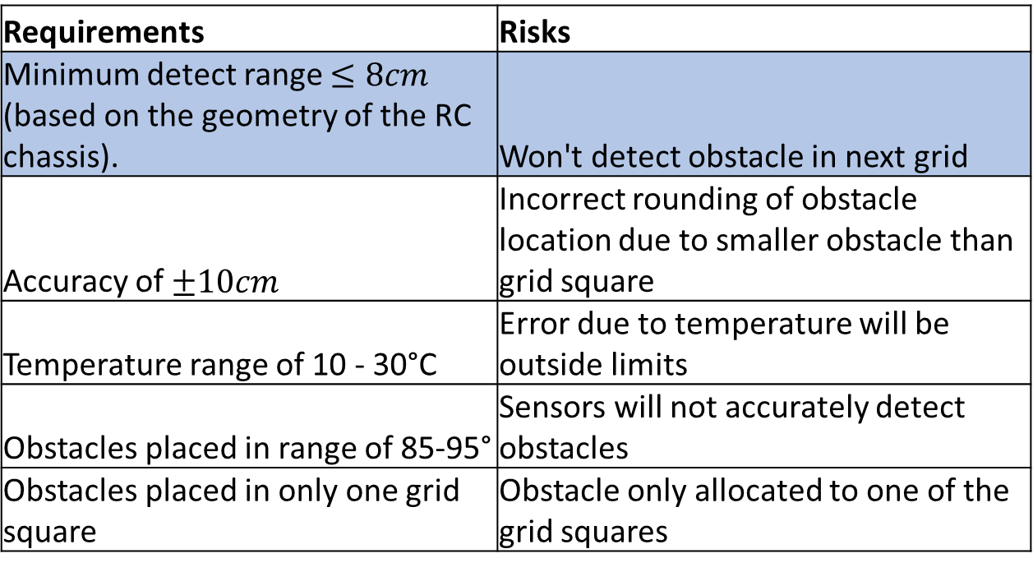
Obstacle Detection System - Risks
Requirements | Risks
Minimum detect range $≤8cm$ (based on the geometry of the RC chassis). | Won't detect obstacle in next grid
Accuracy of $±10cm$ | Incorrect rounding of obstacle location due to smaller obstacle than grid square
Temperature range of 10 - 30°C | Error due to temperature will be outside limits
Obstacles placed in range of 85-95° | Sensors will not accurately detect obstacles
Obstacles placed in only one grid square | Obstacle only allocated to one of the grid squares
Mitigation
Have minimum offset from vehicle as possible
Notes:
There are five major risk factors:
The system shall detect obstacles at a minimum range of $≤8cm$.
Otherwise the system may not detect an obstacle in the adjacent grid as can be seen.
To minimise this risk the offset from the chassis will be as small as possible.

Slide 4
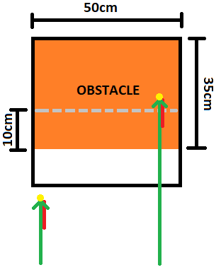
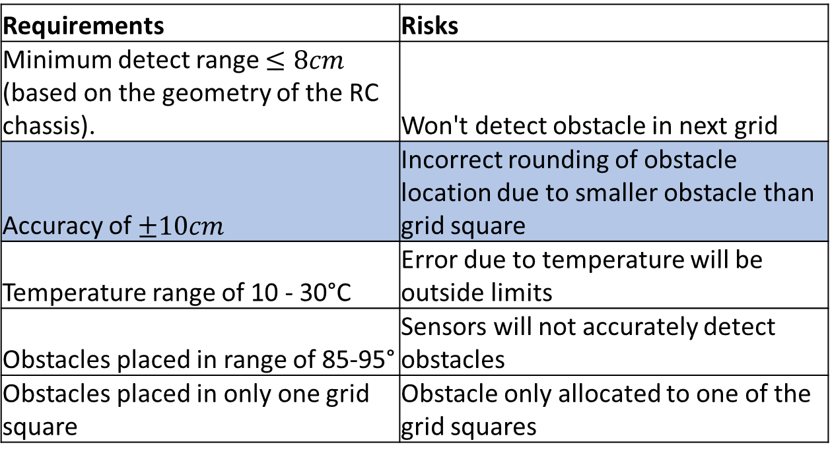
Obstacle Detection System - Risks
Requirements | Risks
Minimum detect range $≤8cm$ (based on the geometry of the RC chassis). | Won't detect obstacle in next grid
Accuracy of $±10cm$ | Incorrect rounding of obstacle location due to smaller obstacle than grid square
Temperature range of 10 - 30°C | Error due to temperature will be outside limits
Obstacles placed in range of 85-95° | Sensors will not accurately detect obstacles
Obstacles placed in only one grid square | Obstacle only allocated to one of the grid squares
Mitigation
Add negative distance bias such that rounding will be correct
Notes:
2. The system shall detect obstacles with an accuracy of at least $±10cm.$
Otherwise based on the difference in the sizes of the obstacles and squares, rounding may cause location errors.
If required, a distance bias will be added to correct rounding issues.

Slide 5
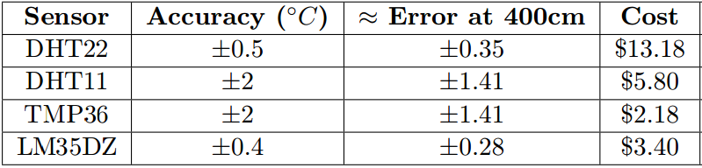
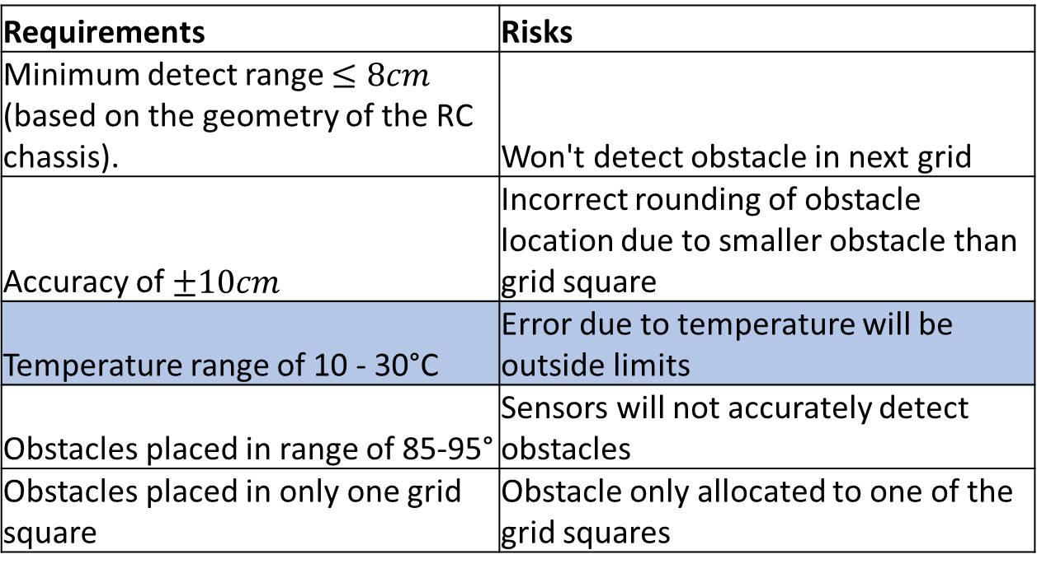
Obstacle Detection System - Risks
Requirements | Risks
Minimum detect range $≤8cm$ (based on the geometry of the RC chassis). | Won't detect obstacle in next grid
Accuracy of $±10cm$ | Incorrect rounding of obstacle location due to smaller obstacle than grid square
Temperature range of 10 - 30°C | Error due to temperature will be outside limits
Obstacles placed in range of 85-95° | Sensors will not accurately detect obstacles
Obstacles placed in only one grid square | Obstacle only allocated to one of the grid squares
Mitigation
Implement a temperature sensor if required
Temperature sensor comparison table:
Notes:
3. Since the speed of sound in air varies with temperature, the system shall operate in a temperature range of $10−{30}^{o}C$.
Otherwise the error in the speed of sound will cause a distance error exceeding limits.
This range should be reasonable, but as a contingency, a temperature sensor has been selected based on the comparisons shown in the table.

Slide 6
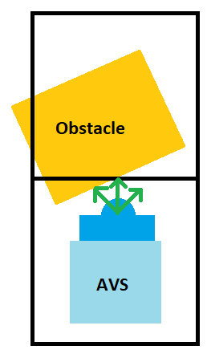
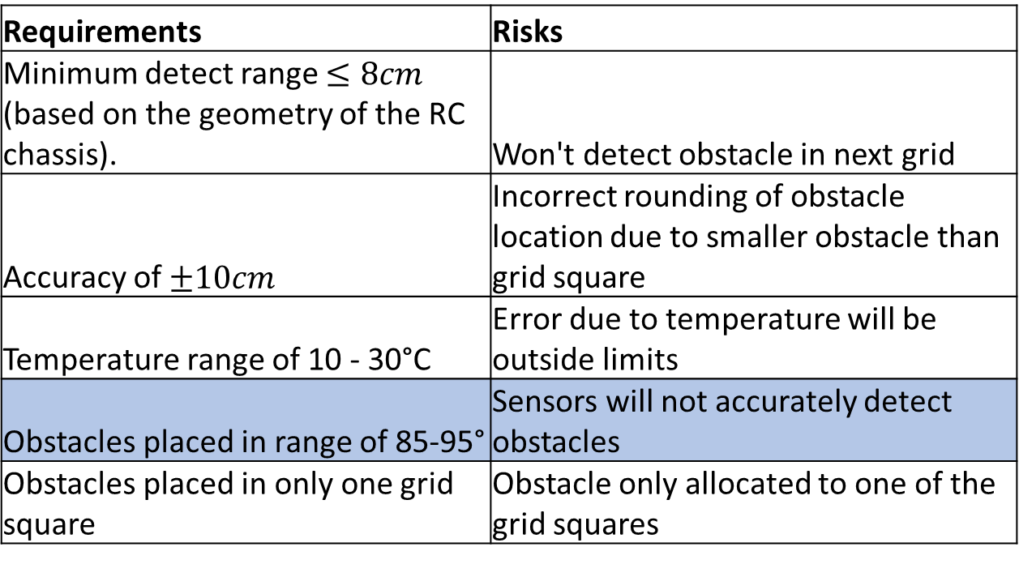
Obstacle Detection System - Risks
Requirements | Risks
Minimum detect range $≤8cm$ (based on the geometry of the RC chassis). | Won't detect obstacle in next grid
Accuracy of $±10cm$ | Incorrect rounding of obstacle location due to smaller obstacle than grid square
Temperature range of 10 - 30°C | Error due to temperature will be outside limits
Obstacles placed in range of 85-95° | Sensors will not accurately detect obstacles
Obstacles placed in only one grid square | Obstacle only allocated to one of the grid squares
Mitigation
Confirm with stakeholder if genuine risk, if so introduce a sweeping technique
Notes:
4. The obstacles are expected to be placed at $±5^{o}$ relative to the grid otherwise the sensors may not work as they need a perpendicular surface.
A sweeping technique could be used to maximise the chance of getting a perpendicular surface.

Slide 7
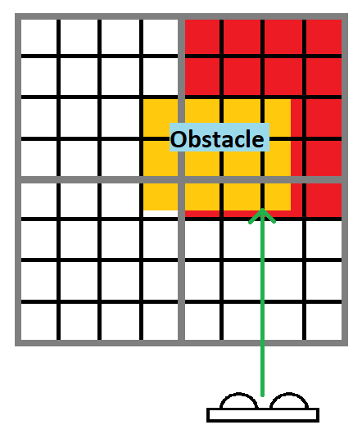
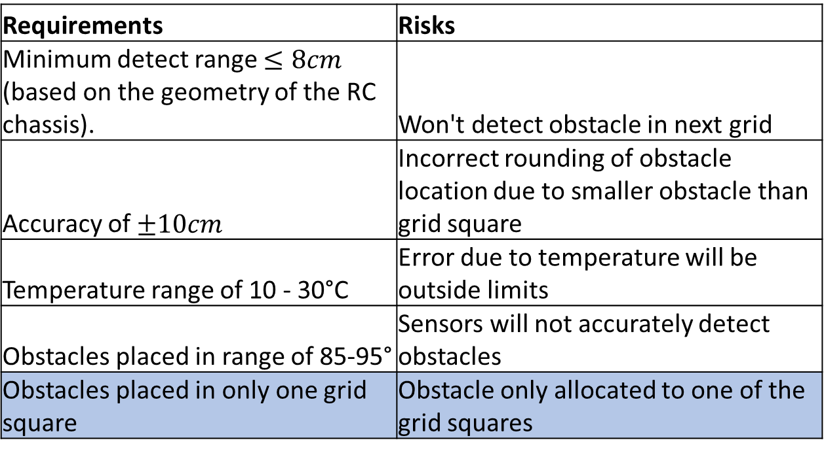
Obstacle Detection System - Risks
Requirements | Risks
Minimum detect range $≤8cm$ (based on the geometry of the RC chassis). | Won't detect obstacle in next grid
Accuracy of $±10cm$ | Incorrect rounding of obstacle location due to smaller obstacle than grid square
Temperature range of 10 - 30°C | Error due to temperature will be outside limits
Obstacles placed in range of 85-95° | Sensors will not accurately detect obstacles
Obstacles placed in only one grid square | Obstacle only allocated to one of the grid squares
Mitigation
Confirm with stakeholder if genuine risk, if so implement smaller detection grid-squares for higher resolution
Notes:
5. The obstacles are expected to be placed in only one grid space, not ‘leaking’ into surrounding squares as shown, because the system will only allocate the obstacle to one of the squares.
If required each square will be broken up into smaller segments for higher resolution as seen.

